Slide 1


PREZENTACJA
Ekologia na co dzień
Scenariusz 3.3.
Grupa wiekowa 15 lat i więcej

Slide 2

JAKI TO DŹWIĘK?
  A – oszczędzających wodę
  B – zużywających nadmiernie wodę
  C – oszczędzających energię
  D – zużywających nadmiernie energię
1
2
3
4
5
6
7
8
9
Notes:
Źródło: Sound Effect by <a href="https://pixabay.com/pl/users/sspsurvival-22364443/?utm_source=link-attribution&utm_medium=referral&utm_campaign=music&utm_content=11228">Semen Surin</a> from <a href="https://pixabay.com/sound-effects//?utm_source=link-attribution&utm_medium=referral&utm_campaign=music&utm_content=11228">Pixabay</a>
Sound Effect by <a href="https://pixabay.com/pl/users/freesound_community-46691455/?utm_source=link-attribution&utm_medium=referral&utm_campaign=music&utm_content=34412">freesound_community</a> from <a href="https://pixabay.com//?utm_source=link-attribution&utm_medium=referral&utm_campaign=music&utm_content=34412">Pixabay</a>
Sound Effect by <a href="https://pixabay.com/pl/users/freesound_community-46691455/?utm_source=link-attribution&utm_medium=referral&utm_campaign=music&utm_content=23892">freesound_community</a> from <a href="https://pixabay.com/sound-effects//?utm_source=link-attribution&utm_medium=referral&utm_campaign=music&utm_content=23892">Pixabay</a>
Sound Effect by <a href="https://pixabay.com/pl/users/freesound_community-46691455/?utm_source=link-attribution&utm_medium=referral&utm_campaign=music&utm_content=83788">freesound_community</a> from <a href="https://pixabay.com/sound-effects//?utm_source=link-attribution&utm_medium=referral&utm_campaign=music&utm_content=83788">Pixabay</a>
Sound Effect by <a href="https://pixabay.com/pl/users/freesound_community-46691455/?utm_source=link-attribution&utm_medium=referral&utm_campaign=music&utm_content=14581">freesound_community</a> from <a href="https://pixabay.com//?utm_source=link-attribution&utm_medium=referral&utm_campaign=music&utm_content=14581">Pixabay</a>
Sound Effect by <a href="https://pixabay.com/pl/users/freesound_community-46691455/?utm_source=link-attribution&utm_medium=referral&utm_campaign=music&utm_content=54059">freesound_community</a> from <a href="https://pixabay.com/sound-effects//?utm_source=link-attribution&utm_medium=referral&utm_campaign=music&utm_content=54059">Pixabay</a>
Sound Effect by <a href="https://pixabay.com/pl/users/freesound_community-46691455/?utm_source=link-attribution&utm_medium=referral&utm_campaign=music&utm_content=62910">freesound_community</a> from <a href="https://pixabay.com/sound-effects//?utm_source=link-attribution&utm_medium=referral&utm_campaign=music&utm_content=62910">Pixabay</a>
Sound Effect by <a href="https://pixabay.com/pl/users/freesound_community-46691455/?utm_source=link-attribution&utm_medium=referral&utm_campaign=music&utm_content=26247">freesound_community</a> from <a href="https://pixabay.com//?utm_source=link-attribution&utm_medium=referral&utm_campaign=music&utm_content=26247">Pixabay</a>
Sound Effect by <a href="https://pixabay.com/pl/users/free-sound-49985424/?utm_source=link-attribution&utm_medium=referral&utm_campaign=music&utm_content=335601">free-sound</a> from <a href="https://pixabay.com/sound-effects//?utm_source=link-attribution&utm_medium=referral&utm_campaign=music&utm_content=335601">Pixabay</a>

Slide 3
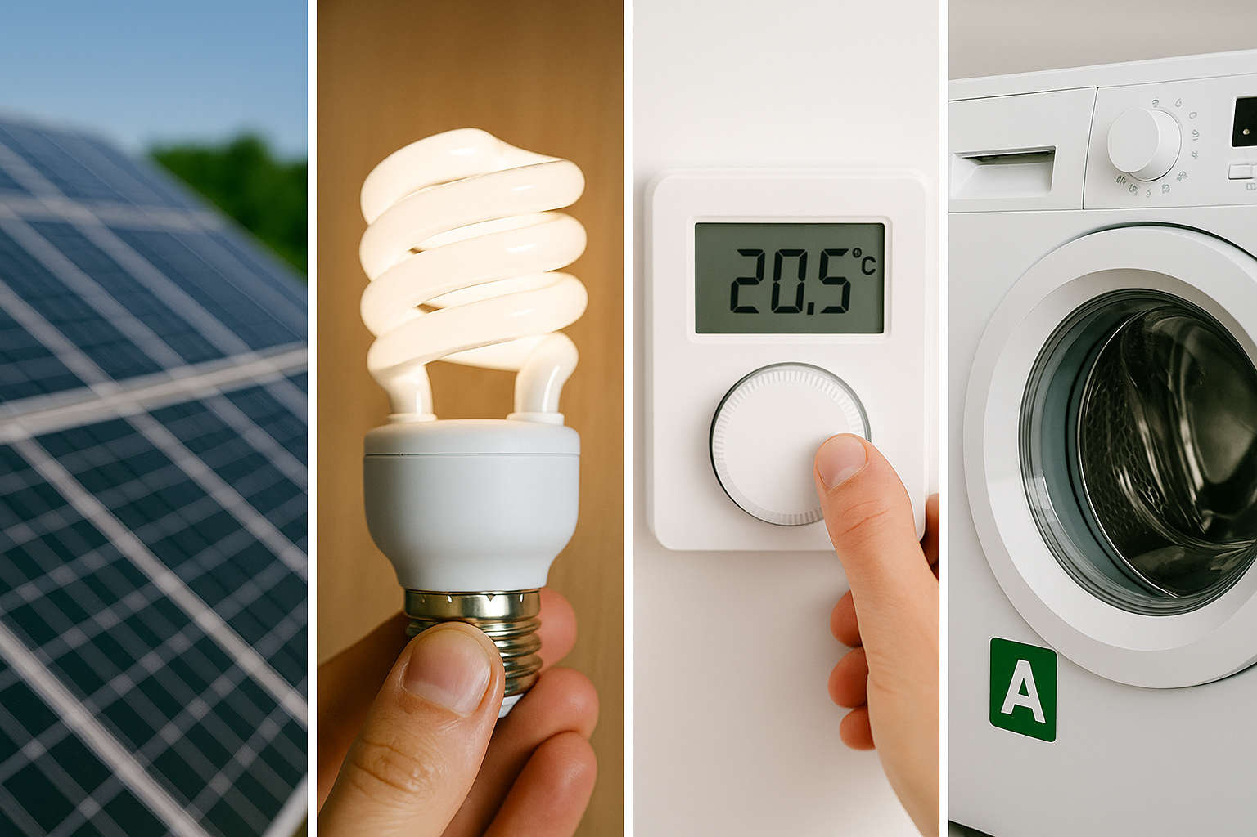


Slide 4
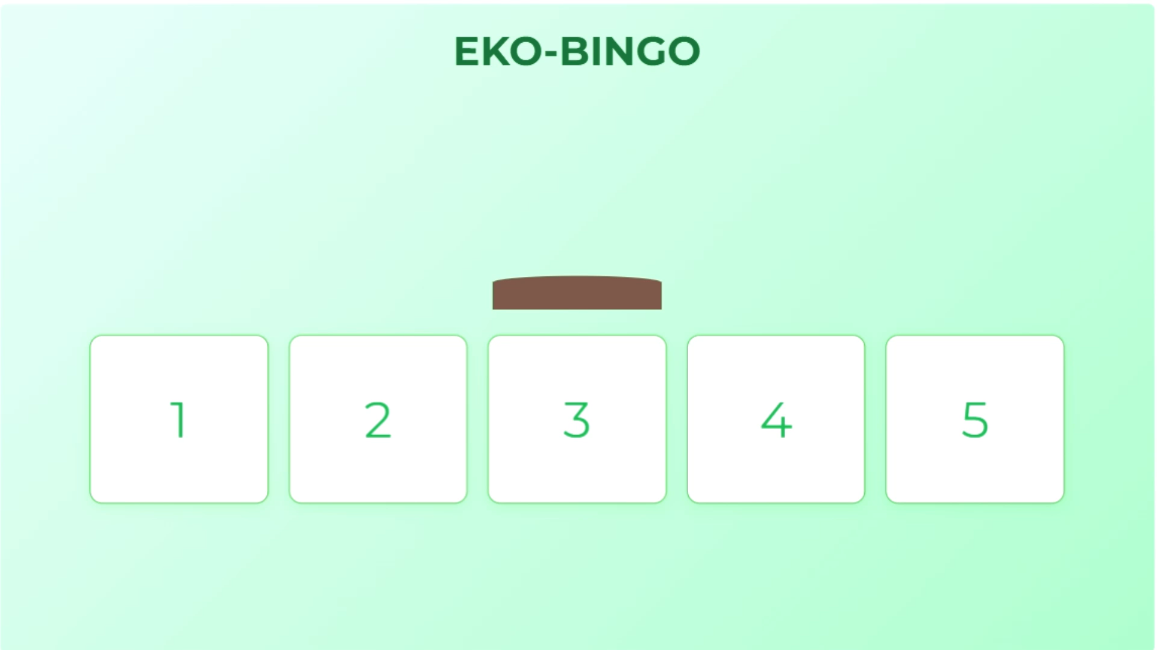

Slide 5
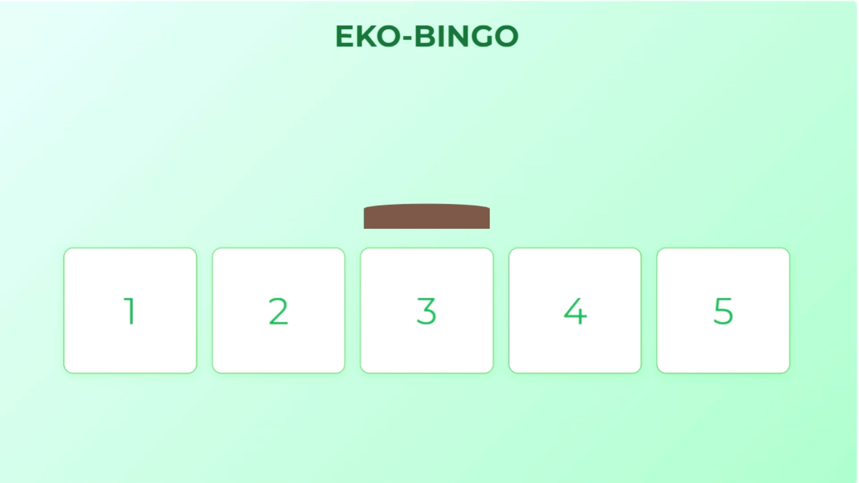

Slide 6


Slide 7
